Slide 1

John White State Superintendent

Slide 2
Louisiana’s
Path to Excellence
Danielle Rowland, M. Ed.

Slide 3
Act 54 and Educator Evaluation
Act 54 requires annual formal evaluations of all teachers and administrators, beginning in 2012-13.
Teacher
and
Leader Evaluations
Measures of Student Growth
50%
Measures of Effectiveness
50%

Slide 4
Measuring Qualitative Performance
Planning Standard 1: The teacher aligns unit and lesson plans
with the established curriculum to meet annual achievement goals.
COMPETENCY
performance STANDARD
descriptors

Slide 5
Defining Effectiveness with Observational Rubrics
Highly Effective
The Educator consistently and considerably surpasses the established performance standard.
Effective
The Educator consistently meets the established performance standard.
Ineffective
The Educator consistently performs below the established performance standard.

Slide 6
Measures of Student Growth
Teacher or Leader Final Evaluation Score
Measures of Student Growth
50%
Other Measures of Effectiveness
50%

Slide 7
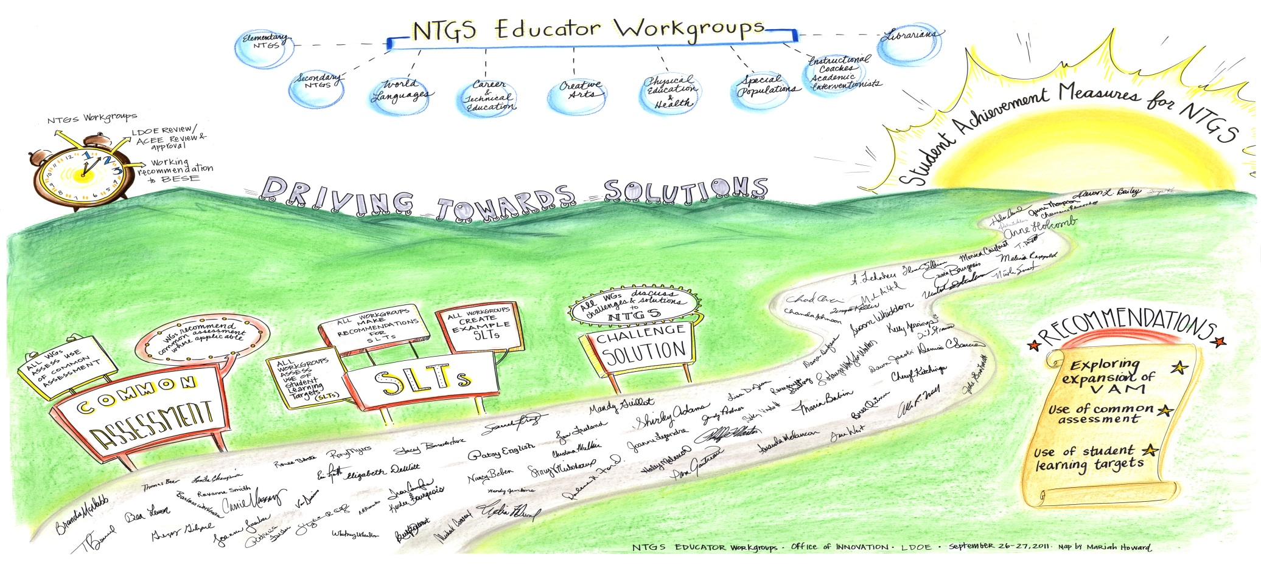
NTGS Workgroup Recommendations

Slide 8
Recommendation #1
The Value-Added Model (VAM) should be used when possible to create a growth score.
Recommendation #2
When VAM is not available, common assessments should be used to establish student learning targets.
Recommendation #3
When neither VAM nor common assessments are available student learning targets should be established using state approved measures of student learning.

Slide 9
NTGS PROCESS FLOWCHART
Teacher/Leader Establish Student Learning Targets (SLT) for NTGS educators
Teacher/Leader review of SLT progress; modifications made, if needed
Leader completes NTGS rubric designed to measure SLT goal attainment
Beginning of Year Meeting
Middle of Year Meeting
End of Year Meeting

Slide 10
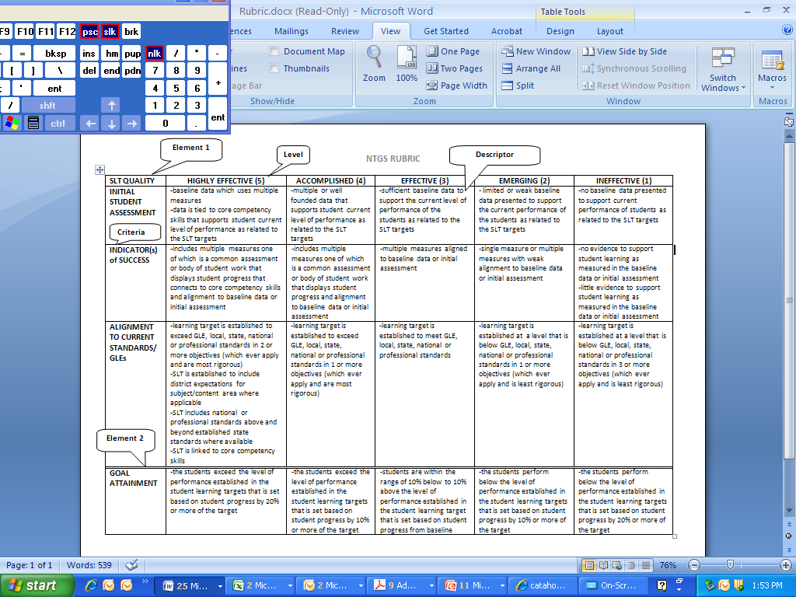

SLT Rubric
Student Learning Targets (SLTs) are assessed on the following criteria, using a standard state rubric:
Quality of Initial Student Assessment
Quality of the Identified Indicators of Success
Alignment to Current Standards
Students’ Goal Attainment

Slide 11
Defining Effectiveness with NTGS
Highly Effective
Uses baseline data to set student learning targets Targets go beyond the established state, national or local standards Compiles an exemplary body of evidence to assess student progress, including state-approved common assessments, where available Students’ performance exceeds the expected outcome
Effective
Uses baseline data to set student learning targets Targets are aligned to state, national or local standards Compiles body of evidence to assess student progress Students’ performance meets the expected outcome
Ineffective
No baseline data to set student learning targets Targets are below state, national or local standards Compiles little to no evidence to assess student progress Students’ performance is below the expected outcome

Slide 12
Which student had the “better” year this school year?
400
350
300
250
200
Current Year Score
Notes:
If you only look at the end result, we would all agree that Red Student had a better year than Blue Student. But, (go forward to next slide)

Slide 13
Which student had the “better” year this school year?
400
350
300
250
200
Prior Score
3 years
Prior Score
2 years
Prior Score
1 year
Current Score
this year
Notes:
…when we see where each child HAD been scoring, and what their trajectories were, we see that in actuality, while Red might have received a higher absolute score, she fell back about 18 points. And at the same time, Blue scored about 18 points higher than he typically had. Blue is at a lower achievement level, but showed growth, and Value-Added is looking for exactly that.

Slide 14
Which Students are Included in
Louisiana’s Value-Added Assessments?
Students are INCLUDED in the Assessment if…
Prior achievement data are available
Students are EXCLUDED from the assessment if…
No prior achievement data is available
Attended school for a full year
Take the regular state assessment
Enrolled in 4-9 grade levels
If a teacher agrees they taught that student
Moved during the school year
Take an alternative state assessment
Enrolled in K-3 or 10-12 grade levels

Slide 15
What information is used to predict achievement?
Variables in Louisiana’s Model:
Prior achievement on State Assessments (ELA, Reading, Mathematics, Science, Social Studies)
Student Attendance
Disability Status (Emotional Disturbance, Speech and Language, Mild Mental Disability, Specific Learning Disability, Other Health Impairment, Other)
Gifted Status
Section 504 Status
Free Lunch Status
Reduced Lunch Status
Limited English Proficiency Status
Discipline Record (Count of Suspensions and/or Expulsions)
Note: Value-Added Assessment is Based on a Mathematical Model that Determines How Much Each Factor Contributes to Estimating Expected Student Achievement. By Far, the Strongest Predictor is Prior Achievement.

Slide 16
What Classroom Information is Used?
Class composition can make a difference in how challenging a group of students is to teach
This is accounted for by including the variables below:
  Percentage of students receiving free lunch
  Students’ mean prior achievement in that content area
  Percentage of students in special education
  Average number of days students were suspended

Slide 17
Sample Formula & Calculation
8th grade student; Math 2009-2010
MATH10=(ED*ED_co) + (SLD*SLD_co) + (MMR*MMR_co) + (OHI*OHI_co) + (SLD*SLD_co) + (SPED*SPED_co) + (FLS*FLS_co) + (RLS*RLS_co) + (LEP*LEP_co) + (GS*GS_co) + (S504*S504_co) + (Sab*Sab_co) + (PSC*PSC_co) + (PEC*PEC_co) + (ZELA0809*ZELA8090_co) + (ZRDG0809*ZRDG0809_co) + (ZMTH0809*ZMTH0809_co) + (ZSCI0809*ZSCI0809_co) + (ZSS0809*ZSS0809_co) + (ZELA0708*ZELA0708_co) + (ZRDG0708*ZRDG0708_co) + (ZMTH0708*ZMTH0708_co) + (ZSCI0708*ZSCI0708_co) + (ZSS0708*ZSS0708_co) + (ZELA0607*ZELA0607_co) + (ZRDG0607*ZRDG0607_co) + (ZMTH0607*ZMTH0607_co) + (ZSCI0607*ZSCI0607_co) + (ZSS0607*ZSS0607_co)
****************************************************************************************
Regression coefficient analysis will be conducted
every year; therefore the weighting for the predictor
variables will change, slightly, from year to year.
***************************************************************************************
Zscore= x – mean of x
Standard Deviation

Slide 18
Sample Formula &Calculation
6th grade student; Math 2008-2009
MATH09=(student absences*-0.257893) + (LEP*1.817055) + (gifted status*4.678991) + (ED*-2.04815) + (SLD*-5.149452) + (MMR*-15.712315) + (OHI*-4.598888) + (Spch/Lng*.068354) + (SPEDother*-3.819725) + (FrLun*-1.110295) + (RedLun*-0.712648) + (Sec504*-1.950893) + (Susp*-.303073) + (Exp*-0.838649) + (ZELA0708*3.340487) + (ZRDG0708*-1.635743) + (ZMTH0708*17.611899) + (ZSCI0708*3.89035) + (ZSST0708*1.874164) + (ZELA0607*-0.524112) + (ZRDG0607*0.369283) + (ZMTH0607*12.726345) + (ZSCI0607*1.157349) + (ZSST0607*0.445228) + (ZELA0506*-1.216389) + (ZRDS0506*-0.781565) + (ZMTH0506*10.081095) + (ZSCI0506*0.076263) + (ZSST0506*-0.208467)
MATH09=(0*-0.257893) + (0*1.817055) + (0*4.678991) + (0*-2.04815) + (0*-5.149452) + (0*-15.712315) + (0*-4.598888) + (0*.068354) + (0*-3.819725) + (1*-1.110295) + (0*-0.712648) + (0*-1.950893) + (0*-.303073) + (0*-0.838649) + (.52807*3.340487) + (1.05118*-1.635743) + (.57082*17.611899) + (1.12409*3.89035) + (1.54118*1.874164) + (.45139*-0.524112) + (1.01532*0.369283) + (1.40111*12.726345) + (.48718*1.157349) + (1.25664*0.445228) + (1.07495*-1.216389) + (1.29221*-0.781565) + (1.22207*10.081095) + (1.26916*0.076263) + (1.35586*-0.208467)
Math Typical Score: 50.11
50.11/50 (standard deviation) = 1.0022 (z-score)
Z-score to standard score: (1.0022*50) + 300 = 350.11 = 350
When restandardizing across grades and contents, the Mean is 300, and SD is 50
(allows for comparability amongst grades and contents)

Slide 19
Stages in the Value-Added Assessment Process
Check with Teachers to Make Certain Rosters are Correct
Compare How Students Did on State Assessments Compared to Their Trajectories
Share Results with Teachers, Principals, and Superintendents

Slide 20
How and to Whom are Results Reported?
Teachers
On CVR (Curriculum Verification Report)
Only His/Her Results
Principals
On CVR(Curriculum Verification Report)
All Teachers in School
Superintendents
On CVR(Curriculum Verification Report)
All Schools/Teachers in District

Slide 21
Value-Added Results
Overall Composite Percentile*
  Allows teachers to see how they compare to other teachers statewide
Rating Scale Score
  Will be used for final evaluation
  1.0-5.0 (5.0 highest)
  Standards to be set by BESE
Individual Content Area Scores*
  English Language Arts, Reading, Mathematics, Science, Social Studies
  Student-Teacher Achievement Results
  Percentile (allows for comparison amongst all teachers in that same content area)
Content Area Breakdown Results*
  Achievement Groups, Students with disabilities, Free lunch students, Limited English proficiency students
*Must have at least 5 students to receive score.

Slide 22
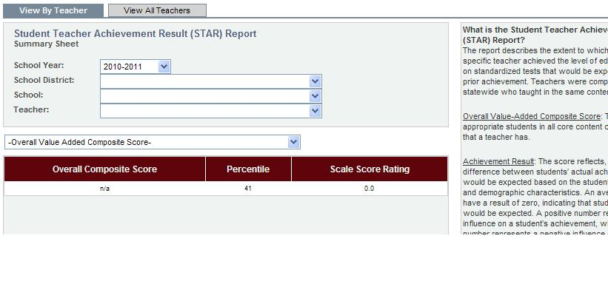
Teacher Score Report
“Overall Composite Score”= N/A for all teachers
“Percentile” = ranking compared to all teachers statewide
“Scale Score Rating” = 5.0-1.0; standards set by BESE
Notes:
For the “Overall Composite Score” every teacher currently has an N/A, and every Scale Score Rating is currently a “0”, which is not one of the numbers that will be used.

Slide 23
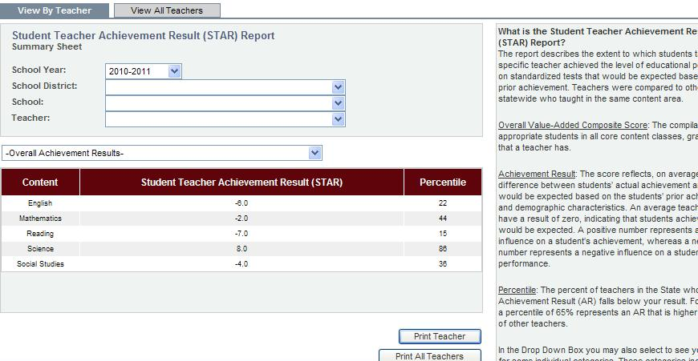
Sample Teacher Results Report
Multiple Content Areas
Percentile comparison is content-specific
Notes:
*Look at the Science and Social Studies STAR…-7 and -8, respectively. If we pretend that this was a report for a teacher who just taught that Science, or just that Social Studies….that negative number indicates that each student scored that many points below typical for them, NOT that the teacher “gets a negative score” (remember, the scores for teachers are only a 5.0-1.0…there ARE no ‘negative scores’ for a teacher)….and if you look at the corresponding percentiles (16 and 19, respectively), those are numbers that would mean a teacher is EFFECTIVE. If this was a Science teacher, whose overall Achievement Result was a -7 and their percentile was a 16, this teacher would NOT be considered by the state to be an ineffective teacher.

Slide 24
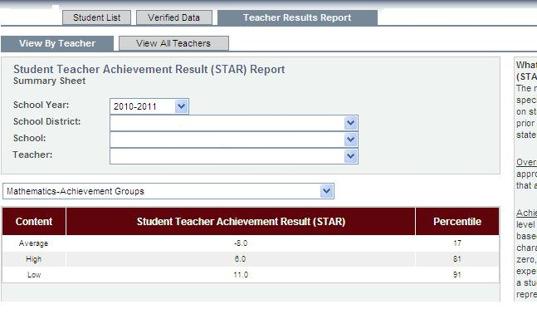
Breakdown of Achievement Groups
Achievement Groups calculated statewide
based upon prior year’s test results.
Notes:
Looking at this slide, we know what’s been going on in this classroom. The teacher took those 4, 5 students right at the ‘Mastery/Advanced’ border and pushed them (High Achievers, +6)…and worked at remediating those who were going to come up to Basic (Low Achievers, +11), but has told those working in the middle (Average Achievers, -8), “Here baby, just let me know if you need any help.”

Slide 25
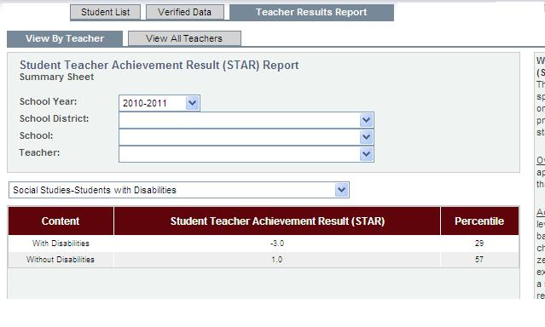
Students with disabilities and
Students without disabilities
Must have at least 5 students who qualify for analysis to get drill-down
Notes:
Not having a drill-down doesn’t mean you didn’t have ANY of those students, just not the minimum of 5 who qualified for inclusion.

Slide 26
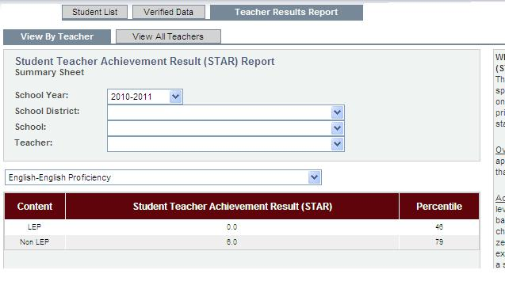
Limited English Proficiency and Non-LEP
Must have at least 5 students who qualify for analysis to get drill-down

Slide 27
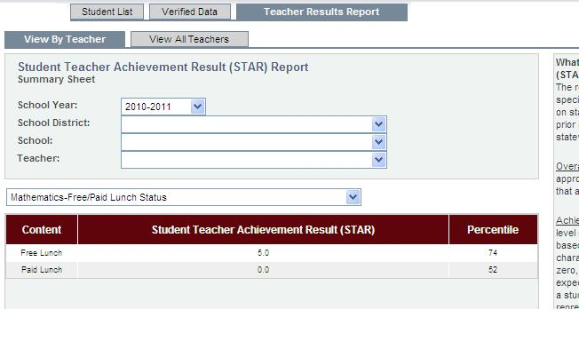
Free Lunch Status and Paid Lunch Status
Must have at least 5 students who qualify for analysis to get drill-down

Slide 28
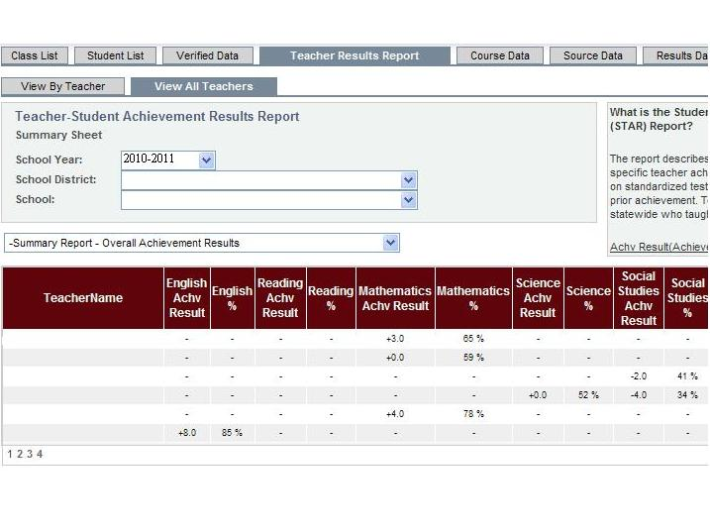
School-wide Overall Achievement Results
Can sort categories by clicking on the headers;
can be in ascending or descending order.

Slide 29
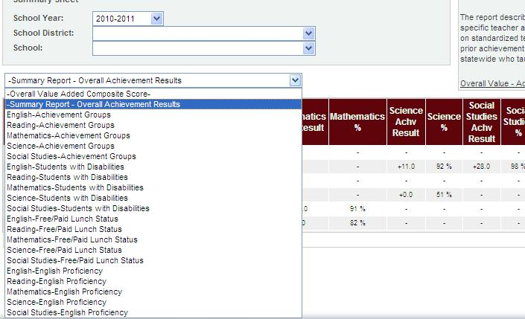
The same drill-downs for teachers are
available for the school as a whole.

Slide 30
Defining Effectiveness with Value-Added

Slide 31
Value-Added Training Resources
Danielle Rowland: Education Consultant, Value-Added Trainer
  To schedule individual training sessions contact: Danielle.Rowland@la.gov
Website: http://www.louisianaschools.net/topics/value_added.html
CVR: https://leads13.doe.louisiana.gov/cvr
CVR Helpdesk: LDOECVR@la.gov

Slide 32
My sincere thanks to A+PEL for arranging and coordinating this evening’s event, and inviting me to talk with all y’all.
~danielle

